Slide 1
CSS3 Techniques
Notes:
CSS3 is an important corollary to HTML5. The standards sit side by side.
This chapter begins our investigation of CSS3 techniques. The following chapters continue this discussion.

Slide 2
Contents
Setting the scene
Controlling layout
Backgrounds, borders, colours, and text
Selectors
Annex
Adaptive rendering
Demos folder for this chapter:
Demos\06-Css3
Notes:
Section 1 explains the role and purpose of CSS3, and outlines some essential theory and concepts.
Section 2 describes the new features in CSS3 that allow you to control the layout of elements on a Web page.
Section 3 looks at various CSS3 styles that enable you to define backgrounds, borders, colours, and text appearance in a Web page.
Section 4 introduces some new syntax in CSS3 for selecting target content in the Web page. The selector syntax has some new features that you'll certainly want to know about.
The annex at the end of the chapter describes how to use media queries to define conditional CSS3 styles, which are dependent on the browser/device that the user is currently using. For example, you can define different CSS rules for small mobile devices, tablets, desktop computers, etc. This allows for adaptive rendering on devices of different shapes and size.

Slide 3
1. Setting the Scene
Overview of CSS3
Vendor-specific prefixes
Example of vendor-specific prefixes
Notes:
We'll begin our journey into CSS3 with a few important concepts and definitions, to get the ball rolling.

Slide 4
Overview of CSS3
CSS plays an important role alongside HTML5
You are strongly advised to delegate presentational issues to CSS
Just use HTML5 for semantic content
CSS3 introduces several new features, including:
Backgrounds and borders
Enhanced color support
Transforms
Selectors
Enhanced font support
Media queries
Namespaces
Additional units and values
Notes:
CSS3 provides a wealth of new stylistic features, to accompany the new HTML5 standard. The slide above lists many of these new features. We'll explore most of these in the next few chapters.

Slide 5
Vendor-Specific Prefixes
Some CSS3 features are not universally supported yet
Vendors use vendor-specific prefixes for some CSS3 features
Denotes partial support for emerging CSS3 standards
Here are some of the common vendor-specific prefixes:
-ms-
Microsoft Internet Explorer
See http://msdn.microsoft.com/en-us/ie/hh393506.aspx
-moz-
Mozilla, Firefox
See https://developer.mozilla.org
-webkit-
WebKit-based browsers, e.g. Safari, Chrome, Opera
See http://developer.apple.com/devcenter/safari/
-o-
Opera (pre February 2013)
See http://www.opera.com/docs/specs/
Notes:
Some of the features defined in the CSS3 specification are not yet cast in stone, which means there's a theoretical possibility that the syntax details might yet change.
For such CSS features, browsers vendors provide vendor-specific prefixes that you place in front of a CSS property to indicate you're not using the "standard" version of the property. In the fullness of time, as the CSS3 standard settles down, the need for these prefixes will dwindle.

Slide 6
Example of Vendor-Specific Prefixes
Examples of vendor-specific prefixes in action:
h4 {
…
-ms-transform: rotate(-45deg);
-webkit-transform: rotate(-45deg);
-moz-transform: rotate(-45deg);
-o-transform: rotate(-45deg);
}
Notes:
This slide shows an example of how to use CSS3 vendor-specific prefixes. The example shows how to define a transformation for <h4> elements, via the CSS3 transform property.
As you can see, you end up having to define several incarnations of the same property, each prefixed by a particular vendor-specific prefix.
Note that there are online tools to help you generate vendor-specific prefixes. For example, see:
http://prefixmycss.com/
http://cssprefixer.appspot.com/
http://modernizr.com/docs/

Slide 7
2. Controlling Layout
Multiple column layout
Grid layout
Additional layout techniques
Notes:
CSS3 provides some new capabilities for laying out content in a Web page. We'll explore these capabilities in this section.

Slide 8
Multiple Column Layout (1 of 2)
CSS3 allows you to create multiple column layouts
To configure multiple column layout:
column-width - Optimal width for columns
column-count - Optimal number of columns
column-gap - Width of gap between columns
column-rule - Width, style, and color of rule between columns
column-span - Number of columns a content block spans
To specify when content should break between columns:
break-before - page, column, avoid-page, avoid-column
break-after - page, column, avoid-page, avoid-column
break-inside - avoid-page, avoid-column
Notes:
CSS3 allows you to divide the width of an element into columns, via the various column-* properties described in the slide. You can also control where and how column breaks occur, via the break-* properties.
The following slide shows an example of columnar layout.

Slide 9
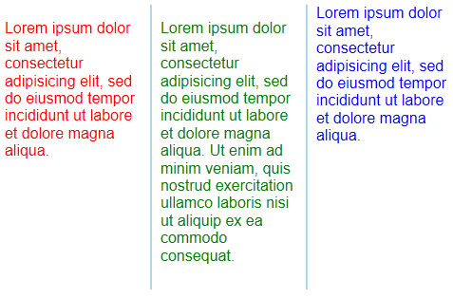
Multiple Column Layout (2 of 2)
Examples of multiple columns (e.g. open in IE11)
MultiColumnLayout1.html shows core features
MultiColumnLayout2.html shows how to control breaks
Notes:
MultiColumnLayout1.html shows core features of columnar layout. It defines columns of a certain width and gap, with a specified column rule style.
MultiColumnLayout2.html shows how to control breaks between columns, by using the break-* properties.

Slide 10
Grid Layout (1 of 3)
CSS3 supports grid layout
Set the display property to grid
Set the grid-rows and grid-columns properties, to indicate the size of the rows and columns
Note that some browsers require vendor-specific prefixes
E.g. for Microsoft IE 11:
someElement {
display: grid;
grid-rows: 50px 400px 50px;
grid-columns: 150px 450px 150px;
…
}
someElement {
display: -ms-grid;
-ms-grid-rows: 50px 400px 50px;
-ms-grid-columns: 150px 450px 150px;
…
}
Notes:
CSS3 also allows you to arrange elements in a grid, via various grid-* properties. The examples in the slide show how to partition a "container" element into three rows and three columns, of the specified sizes.

Slide 11
Grid Layout (2 of 3)
To position an element in a particular cell:
Set grid-row and grid-column for the element
Note that the first cell is row 1, column 1!
To indicate an element should span more than one cell:
Set grid-row-span and grid-column-span
To specify the alignment for an element in a cell:
Set grid-row-align and grid-column-align
Allowed values are start, end, center, and stretch
Note: Some browsers require vendor-specific properties
E.g. -ms-grid-row, -ms-grid-column, etc.
Notes:
After you've defined the overall grid layout for the "container" element, you can then specify which cell each "contained" element should occupy. You do this via the grid-row and grid-column properties.
You can indicate that an element should span several rows or columns via the grid-row-span and grid-column-span properties. You can also specify alignment within a cell via the grid-row-align and grid-column-align properties.

Slide 12
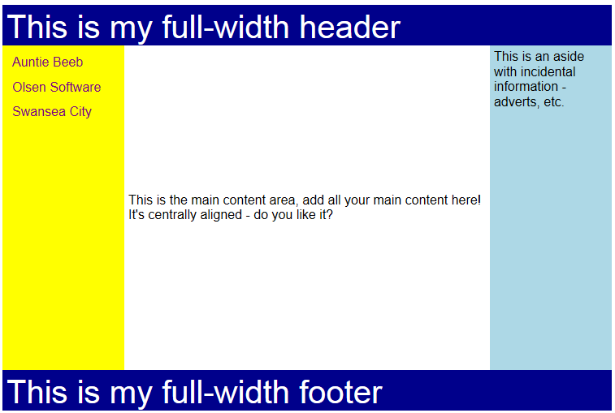
Grid Layout (3 of 3)
Example of grid layout
Open GridLayout.html in IE 11
This example uses Microsoft prefixes -ms-
Notes:
This slide shows an example of grid layout in HTML5.

Slide 13
Additional Layout Techniques
Table layout (since CSS2)
Set the display property to table
See http://www.w3.org/TR/CSS2/tables.html
Flexible box layout (new in CSS3)
Set the display property to flexbox
See http://www.w3.org/TR/css3-flexbox/
For a good example of responsive web design…
See http://www.w3schools.com/css/css_rwd_grid.asp
See http://www.responsivegridsystem.com/
Notes:
To conclude this section, note that HTML also supports table layout and flexbox layout. For more information, see the URL links in the slide.

Slide 14
3. Backgrounds, Borders, Colours, and Text
Drawing outlines
Controlling overflow
Creating rounded corners
Creating drop shadows
Setting colours
Styling text
Notes:
CSS3 allows you to fine-tune the appearance of elements by defining drop shadows, rounded corners, and various other effects. We'll explore these effects in this section.

Slide 15
Drawing Outlines
CSS3 enhances the classic CSS box model with outlines
Outlines are drawn above the margin box
Can be non-rectangular
Individual outline properties:
Shorthand outline property:
See BackgroundsBordersColours\Outlines.html
outline-width: amount
outline-style: a style (e.g. none, dotted, dashed, solid)
outline-color: aColor
outline-offset: distance between outline and border
outline: theOutlineWidth theOutlineStyle theOutlineColor
Notes:
The example in Outlines.html shows the effect of CSS3 outlines:

Slide 16
Controlling Overflow
CSS3 allows you to define what should happen if content overflows the box that contains it
Set the overflow-x and overflow-y properties
Values are visible (the default), hidden, and scroll
CSS3 also allows you to mark a text block as resizable (if the overflow property is hidden or scroll)
Set the resize property
Values are none (the default), both, horizontal, vertical
Notes:
CSS3 allows you to indicate whether an element should overflow the screen real estate defined by its containing element, via the overflow-x and overflow-y properties. You can also specify whether text is resizable via the resize property.

Slide 17
Creating Rounded Corners (1 of 3)
You can apply rounded corners in CSS3
To apply the same rounding to each corner:
You can specify separate rounding on each corner
You can use short-cut syntax:
Or you can set each corner individually:
border-radius: amount;
amount can be a length or a percentage
E.g. 20px
E.g. 10em
E.g. 5%
border-radius: ul ur lr ll;
border-top-left-radius: amount;
border-top-right-radius: amount;
border-bottom-left-radius: amount;
border-bottom-right-radius: amount;
Notes:
One of the nice new features in CSS3 is the ability to define rounded corners for elements, via the border-radius family of properties. There's quite a lot of flexibility, as shown in the slide.

Slide 18

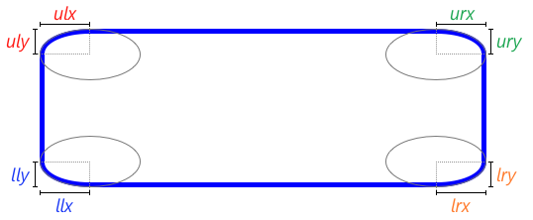
Creating Rounded Corners (2 of 3)
You can also specify elliptical rounding for a corner
Define the x radius and the y radius separately
Note, this isn’t universally supported yet
To set one corner:
To set all corners:
border-top-left-radius: x y;
border-radius: ulx urx lrx llx /
uly ury lry lly;
Notes:
You can specify different sizes for the horizontal and vertical radii, to create elliptical corners as shown in the slide.

Slide 19
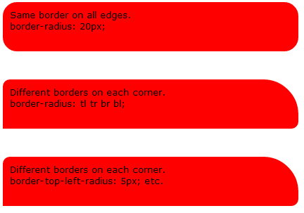
Creating Rounded Corners (3 of 3)
Examples
See BackgroundsBordersColours\Borders.html
Notes:
This slide shows an example of rounded corners. The text displayed in each box is like a comment, to describe the CSS3 styles active on each box.

Slide 20
Creating Drop Shadows (1 of 2)
You can add drop shadows inside or outside elements
box-shadow: horiz-offset
vert-off
blur-distance
spread-distance
color
inset;
horiz-offset (required) Specifies how far to the right (+ve) or to the left (-ve) the shadow extends
vert-offset (required) Specifies how far down (+ve) or up (-ve) the shadow extends
blur-distance Positive length, indicates distance between start and end of the blur
spread-distance Specifies how much the shadow shape expands (+ve) or contracts (-ve) in all directions
color (required for some browsers) Color of the shadow (e.g. gray or #808080)
inset Use this keyword if you want an inner shadow rather than an outer shadow
Notes:
You can define drop shadows on elements via the box-shadow property. Note that the horiz-offset and vert-offset values are required, whereas the other values are optional for most browsers.

Slide 21
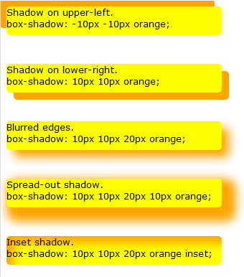
Creating Drop Shadows (2 of 2)
Examples
See BackgroundsBordersColours\Shadows.html
Notes:
This slide shows an example of drop shadows. As in the earlier example, the text displayed in each box is like a comment, to describe the CSS3 styles active on each box.

Slide 22
Setting Colours (1 of 3)
CSS3 provides several ways to set colours…
rgba(r, g, b, a)
Red, Green, and Blue (0 to 255, or 0% to 100%)
Alpha (0.0 = completely transparent, 1.0 = completely opaque)
hsl(h, s, l)
Hue, i.e. color’s angle on the color wheel (0=R, 120=G, 240=B)
Saturation (0 to 100%)
Lightness (0 to 100%)
hsla(h, s, l, a)
Hue, saturation, and lightness as above
Alpha (0.0 = completely transparent, 1.0 = completely opaque)
Notes:
CSS3 provides various ways for you to define colours. Note that you can still use the rgb() function from CSS2 ☺.

Slide 23
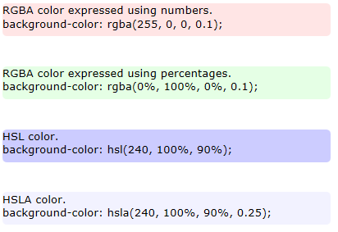
Setting Colours (2 of 3)
Examples
See BackgroundsBordersColours\Colours.html
Notes:
This slide shows an example of defining colours in CSS3. Note that the opacity is quite low for each box, which explains why the colours look quite transparent.

Slide 24
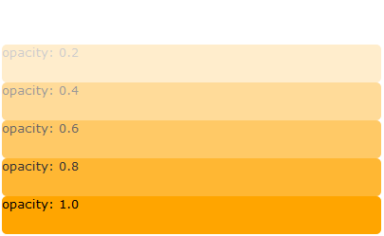
Setting Colours (3 of 3)
You can also set the opacity style on any element
Similar to the alpha component of RGBA and HSLA values
Values 0.0 (completely transparent) to 1.0 (completely opaque)
Example
See BackgroundsBordersColours\Opacity.html
Notes:
You can set the opacity style on elements as follows:
<div>
<div style="background: orange; opacity: 0.0;">opacity: 0.0</div>
<div style="background: orange; opacity: 0.2;">opacity: 0.2</div>
<div style="background: orange; opacity: 0.4;">opacity: 0.4</div>
<div style="background: orange; opacity: 0.6;">opacity: 0.6</div>
<div style="background: orange; opacity: 0.8;">opacity: 0.8</div>
<div style="background: orange; opacity: 1.0;">opacity: 1.0</div>
</div>
The result is shown in the slide.
The demo folder also contains an OpacityWithBackgroundImage.html example, which shows background images showing through the orange boxes:

Slide 25
Styling Text
To indent first line of each text block
Set the text-indent property
To tell browser how to hyphenate
Set the hyphens property
Allowable values are none, manual, or auto
For manual hyphens, use &shy; to indicate hyphenation points
To define spacing between words
Set the word-spacing property
To define text shadows
Set the text-shadow property
text-indent: 5rem;
hyphens: manual;
word-spacing: 5px;
text-shadow: horiz-offset
vert-off
blur-distance
color;
Notes:
To conclude this section, we point out various additional features in CSS3 that allow you to control textual layout on a Web page. These are all fairly intuitive.

Slide 26
4. Selectors
Structural pseudo-classes
Additional selector techniques
Combinators
Notes:
CSS selectors are patterns that match against elements in a tree. Selectors enable you to use CSS to select nodes in an HTML document, without the need for DOM / JavaScript coding.
CSS3 introduces several new selectors. We’ll take a look at the new selectors in this section. Full information is also available here:
http://www.w3.org/TR/css3-selectors/

Slide 27
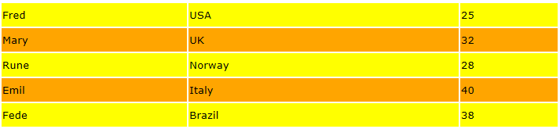
Structural Pseudo-Classes (1 of 2)
Structural pseudo-classes permit selection based on an element’s position in the document tree
E.g. root element
E.g. nth-child
E.g. first child of a certain type
Simple example:
See Selectors\StructuralPseudoClasses1.html
…
tr:nth-child(odd) {
background-color: yellow;
}
tr:nth-child(even) {
background-color: orange;
}
…
Notes:
CSS3 allows you to define rules for elements, based on their position relative to a parent node (e.g. the first row in a table, the last row, even rows, odd rows, etc.).

Slide 28
Structural Pseudo-Classes (2 of 2)
For n, you can specify:
A number, e.g. 5
A cyclic condition, e.g. 3n
An expression, e.g. 3n+1
The words odd or even
Structural pseudo-class
Selects an E element that is …
Examples: Selectors\StructuralPseudoClasses2.html
Info: http://reference.sitepoint.com/css/selectorref
E:root
The root of the document
E:nth-child(n)
E:nth-last-child(n)
The n-th child of its parent (counted from first or last)
E:nth-of-type(n)
E:nth-last-of-type(n)
The n-th sibling of its type (counted from first or last)
E:first-child
E:last-child
The first or last child of its parent
E:first-of-type
E:last-of-type
The first sibling or last of its type
E:only-child
The only child of its parent
E:only-of-type
The only sibling of its type
E:empty
Empty (i.e. has no children – including text nodes)
Notes:
This slide summarizes all the options for defining rules based on structural pseudo-classes. The demo shows various examples, such as the following rules:
li:first-child {
color: orange;
}
li:not(.invisible):nth-last-child(5) {
background-color: red;
}

Slide 29
Additional Selector Techniques
Additional pseudo-classes:
Pseudo-elements:
Examples: Selectors\AdditionalTechniques.html
Pseudo-class
Selects a form control element E that is …
E:enabled E:disabled
Elements that are enabled or disabled
E:checked
Elements that are selected
E:not(s)
Elements that are not selected by the selector argument, s
Pseudo-element
Meaning
E:first-letter
E:first-line
Selects the first letter or line of the element
E:before
E:after
Generates content before or after the element
E::selection
Selects any part of the page that the user has highlighted
Notes:
CSS3 allows you to define rules based on whether an element is enabled or disabled, or checked. You also have the ability to define different styles for the first letter or line of text, and to generate content before or after an element.
See the demo for an example of all these features.

Slide 30
Combinators
CSS combinators enable you to combine selectors
Descendant combinator
Child combinator
Adjacent sibling combinator
General sibling combinator
Examples:
See Selectors\Combinators_Xxx.html demo files
h1 em
div * p
form * input[type='text']
span > p
span ul>li span
h3 + p
h3.loud + p
h3 ~ p
h3.loud ~ p
Notes:
You can combine selectors in various ways, as shown in the slide. We've provided four demos to illustrate these techniques:
Combinators_Descendant.html
Combinators_Child.html
Combinators_AdjacentSibling.html
Combinators_GeneralSibling.html

Slide 31
Summary
Setting the scene
Controlling layout
Backgrounds, borders, colours, and text
Selectors

Slide 32
Annex: Adaptive Rendering
Default rendering
Using the viewport meta tag
Overview of media queries
Using simple media queries
Going further with media queries
Media features
Media query listeners
Example

Slide 33
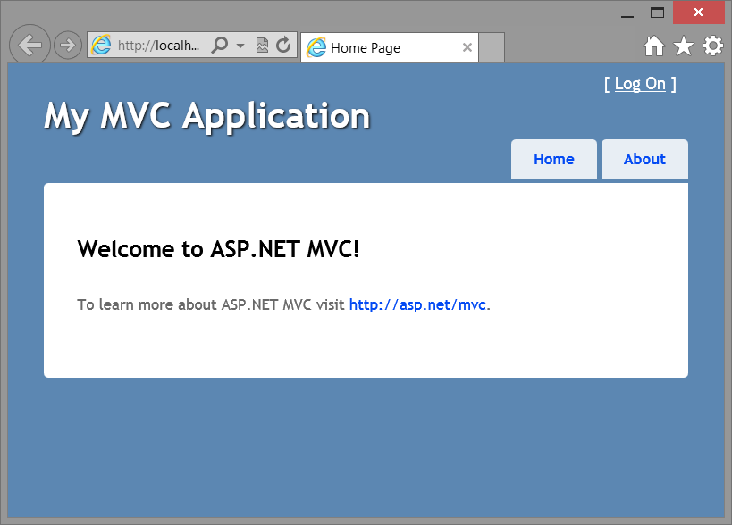
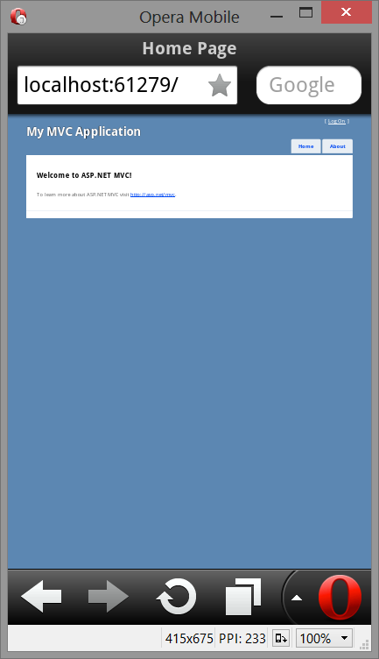
Default Rendering
By default, browsers assume they are rendering pages on a desktop (even browsers on a mobile device!)
Browsers display content at a width of 980 pixels, zoomed out
Example:
Looks OK on a desktop
Looks bad on a mobile

Slide 34
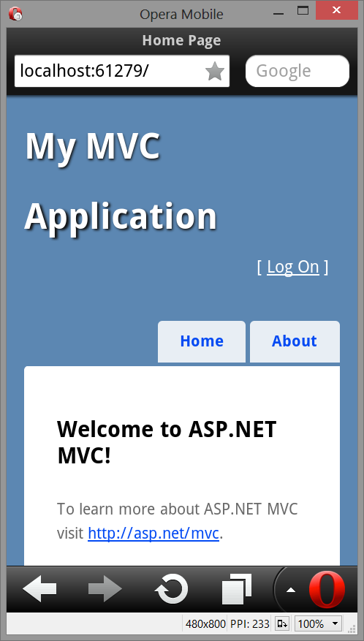
Using the Viewport Meta Tag
You can tell the browser to render the content based on the capabilities of the device
Add a viewport meta tag to the <head> of the layout page
<meta name="viewport" content="width=device-width" />
Still looks OK on a desktop
Now looks OK on a mobile!

Slide 35
Overview of Media Queries
HTML4 and CSS2 support media-dependent style sheets
Tailored for different media types
For example:
A document can use different style sheets for the screen and print:
A style sheet can declare sections for certain media types:
Common HTML4 / CSS2 media types:
screen, print, all, braille, handheld, projection, tty
<link rel="stylesheet" type="text/css" media="screen" href="sans-serif.css">
<link rel="stylesheet" type="text/css" media="print" href="serif.css">
@media screen {
* { font-family: sans-serif }
}

Slide 36
Using Simple Media Queries
A media query is:
A media type followed by zero or more expressions
Expressions check for the conditions of particular media features
For example:
A document can use a media query when linking a style sheet:
A style sheet can use a media query when importing a style sheet:
A style sheet can use a media query in a rule:
<link rel="stylesheet" type="text/css" media="screen and (color)" href="col.css">
@import url("col.css") screen and (color);
@media screen and (color) { … }

Slide 37
Going Further with Media Queries
You can define media queries that apply to all devices, subject to some constraints
You can specify a logical OR clause in a media query
Use a comma-separated list of media queries
You can specify a logical NOT clause in a media query
Use the not keyword to negate the result
@media (min-width: 500px) { … }
@media (orientation: portrait) { … }
@media screen and (color), projection and (color) { … }
@media not screen and (color) { … }

Slide 38
Media Features
You can use these features a media query expression:
See http://www.w3.org/TR/css3-mediaqueries/#media1
Media feature
Description
width, height
Width and height of targeted display area (e.g. 25cm)
device-width, device-height
Width and height of rendering surface (e.g. 800px)
orientation
Either portrait or landscape
aspect-ratio
Ratio of the width:height media features (e.g. 16/9)
device-aspect-ratio
Ratio of the device-width:device-height media features
color
Number of bits per color component of the output device
color-index
Number of entries in the color lookup table of the output device
monochrome
Number of bits per pixel in a monochrome frame buffer
resolution
Resolution (i.e. pixel density) of the output device (e.g. 80dpi)
scan
The scanning process for TV output devices
grid
Queries whether the output device is a grid or bitmap

Slide 39
Media Query Listeners
In CSS3, the CSSOM View module enables you to evaluate a media query at run-time in script
Call matchMedia() on your document's Window object
Returns a MediaQueryList object
You can register for call-backs whenever the evaluation of the media query changes
Called when media query changes from true to false, or vice versa
var mediaQueryList = window.matchMedia("(min-width:900px)");
isLargeScreen = mediaQueryList.matches;
mediaQueryList.addListener(mediaSizeChangeHandler);
function mediaSizeChangeHandler(mql) {
if (mql.matches) {
// The window width is at least 900px, so display wide-screen content ☺.
}
else {
// The window width is less than 900px, so display small-screen content ☹.
}
}

Slide 40
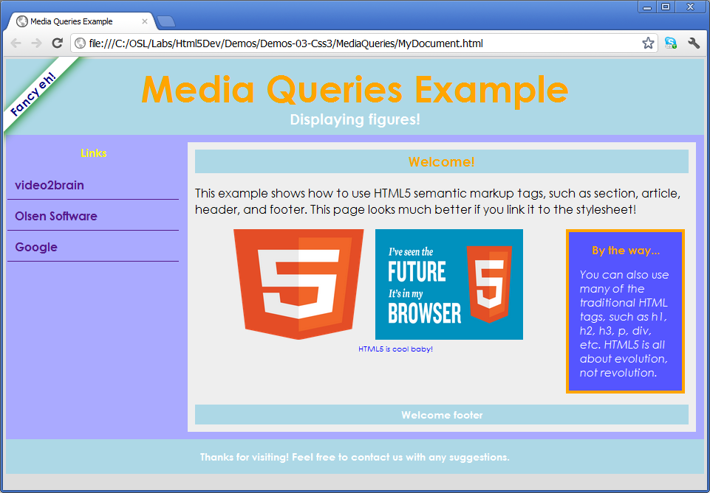
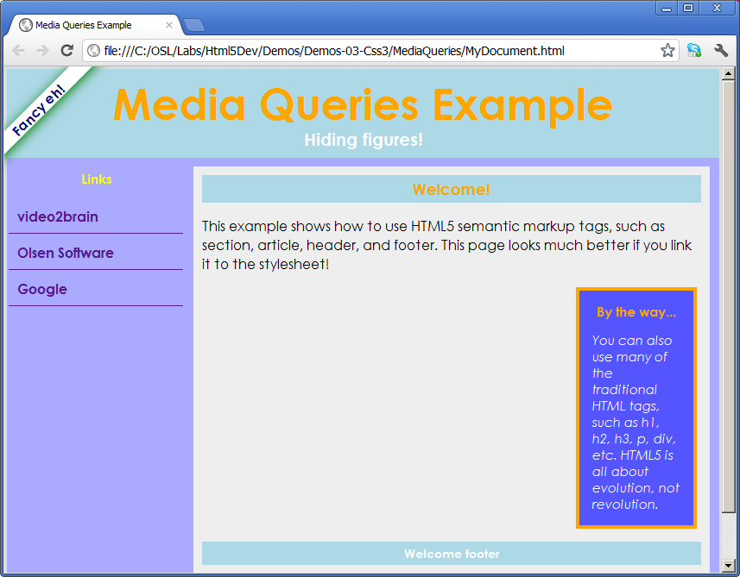
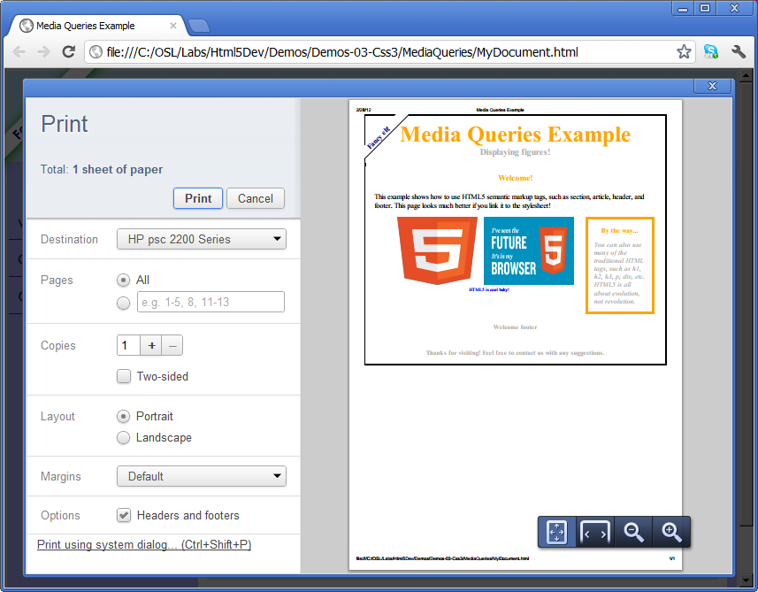
Example
See MediaQueries/MyDocument.html

Slide 41
Any Questions?

